Slide 1

Using AsyncStorage for Persistent Data
A lightweight key-value storage solution for React Native with a simple API for persisting app data between sessions.
Did you know 94% of mobile apps require some form of data persistence?

Slide 2


What is AsyncStorage?
React Native Storage
Key-Value System
Local storage solution built specifically for React Native applications.
Asynchronous, unencrypted storage with a global namespace across your app.
Community Maintained
Available via @react-native-async-storage/async-storage with up to 6MB capacity.

Slide 3





When to Use AsyncStorage
User Preferences
Auth Tokens
Store settings that persist between app launches.
Save non-sensitive authentication data.
Form & App State
Offline Caching
Preserve user input and application state.
Cache data for offline access.

Slide 4
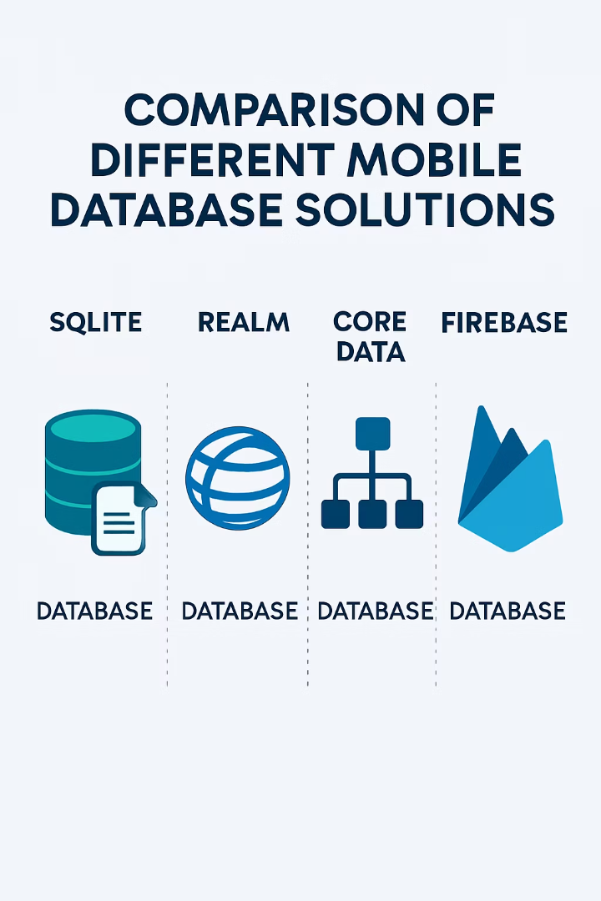
AsyncStorage vs Alternatives
Solution
Type
Encryption
Size Limit
AsyncStorage
Key-Value
No
~6MB
SecureStore
Key-Value
Yes
2KB per value
SQLite
Relational DB
Optional
Larger
Realm
Object DB
Optional
Larger

Slide 5

Getting Started with AsyncStorage
Installation
Run npm install @react-native-async-storage/async-storage in your project.
Import
Add import AsyncStorage from '@react-native-async-storage/async-storage' to your file.
Implementation
Use basic operations: setItem, getItem, removeItem, and clear.

Slide 6





Basic CRUD Operations
Create/Update
AsyncStorage.setItem(key, value)
Read
AsyncStorage.getItem(key)
Delete
AsyncStorage.removeItem(key)
Delete All
AsyncStorage.clear()

Slide 7








Storing Complex Data
Serialize
Store
Convert objects to strings using JSON.stringify()
Save serialized data with AsyncStorage.setItem()
Parse
Retrieve
Convert back to objects with JSON.parse()
Get data with AsyncStorage.getItem()

Slide 8

Batch Operations
Performance Benefits
Batch operations are 40% faster than individual calls. They optimize storage access and reduce overhead.
Example:
AsyncStorage.multiSet([
['key1', 'value1'],
['key2', 'value2']
])
Available Methods
multiSet
multiGet
multiRemove

Slide 9




Error Handling Best Practices
Implement try/catch
Wrap AsyncStorage operations in error handling blocks
Create fallbacks
Prepare alternatives when data isn't available
Add retry logic
Implement mechanisms for critical operations
Enable logging
Track persistence issues for debugging

Slide 10





Data Management Strategies
Namespace Keys
Utility Functions
State Management
Data Versioning
Use prefixes like '@myapp:user:preferences' to organize data and prevent conflicts with other libraries. Example: AsyncStorage.setItem('@myapp:settings:theme', 'dark').
Create wrapper functions like storeData(key, value) and getData(key) that handle JSON serialization and error handling automatically. Centralize these in a StorageService.js file.
Connect AsyncStorage with Redux using persist-redux to automatically sync your store. Configure persistConfig with whitelist/blacklist to control which reducers are persisted.
Store a schema version alongside your data (e.g., '@myapp:version': '1.2.0'). On app launch, check version and run migration functions to update stored data structures when needed.

Slide 11




Security Considerations
AsyncStorage is unencrypted by default. Never store passwords or API keys.
Use SecureStore for authentication tokens. Implement data sanitization and consider obfuscation when needed.

Slide 12





Key Takeaways
Simple Solution
AsyncStorage offers straightforward data persistence for React Native apps.
Right Tool
Choose AsyncStorage for preferences, non-sensitive data, and caching.
Security Aware
Remember limitations: unencrypted, ~6MB capacity, string-only storage.
Best Practices
Implement error handling, batching, and consistent naming conventions.

